Slide 1

The Dolphin
Design
Group 18:
Kandyce Burks
Dieu Do
Luis Hernandez
Brent Yurek

Slide 2
Design Goals
Sonar Mapping as fast as possible
Vital information calculations as fast as possible
Battery lasts longer than average dive
No bugs!!! (unrealistic reach goal)
Simultaneously take in input during calculations

Slide 3
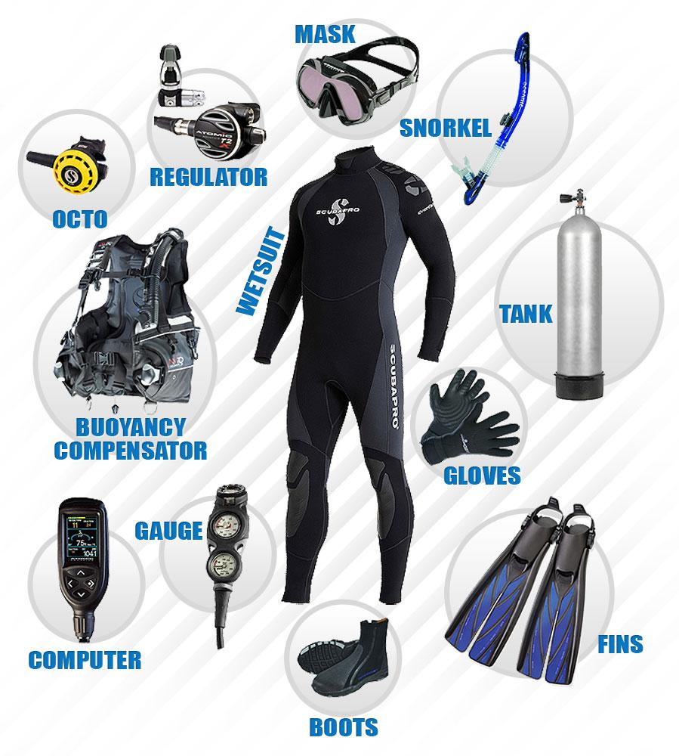
Software Architecture
Modifications:
HUD incorporated
HUD connected to Tank
Add rotational sonar on the head that connects to the microprocessor
Modifications:
Add rotational sonar on the back of tank that connects to microprocessor
Pressure sensor on the tank’s valve that connects to the microprocessor
Modifications:
Add pressure sensor clipped on the wetsuit that connects to the microprocessor
Add gyroscope clipped on the wetsuit that connects to the microprocessor

Slide 4
Software Architecture Cont.
HUD
SonarMapping
SonarSignaling
Distance
Clock
DepthLevel
Alerts
Brightness
Languages
Pressure
Units
AirTime
Speed
Multiple classes all interacting and communicating to provide a seamless workflow!

Slide 5
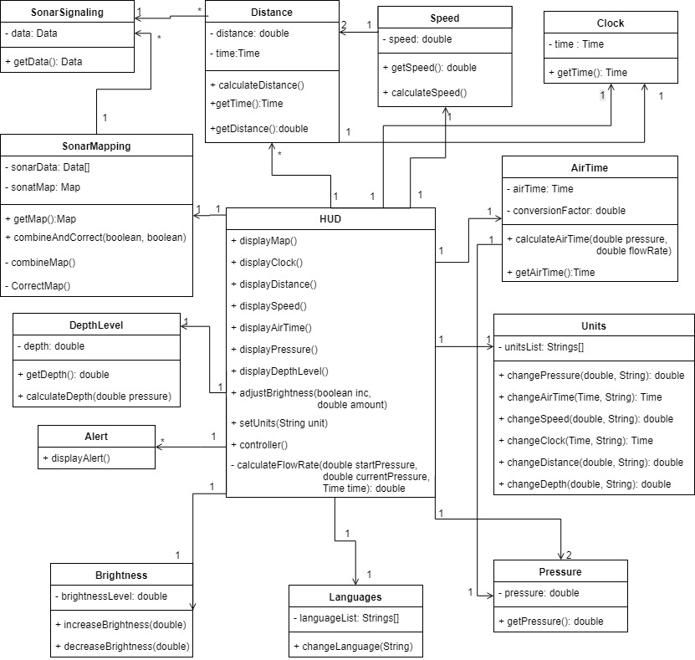
Diagram :

Slide 6
Subsystem
Application
Core functionality of the system
User Interface
Interface that users sees and interact with via HUD display
Persistent Data Storage
Provides data storage
Peripherals
Takes in data to provide to Application

Slide 7
Hardware and Software Mapping
Peripherals
Hardware:
Air Pressure Sensor
Depth Gauge
Sonar Equipment
Application
User Interface
Persistent Data Storage

Slide 8
Subsystem Services: Application
getPressure()
getDepth()
getData()
getAirTime()
Input from peripherals
calculateAirTime()
getMap()
combineMap()
correctMap()
calculateDistance()
calculateSpeed()
calculateAirTime()
Computations
Sends data to UI for display

Slide 9
Subsystem Services: Peripherals
All the hardware in the system
Takes in data and commands to send to Application for computation
Air pressure sensor
Depth Gauge
Sonar Emitter and Receiver
Buttons

Slide 10
Subsystem Services: Persistent Data Management
Flat files
No database
Used for persisted settings
Brightness
Units
Language

Slide 11
User Interface Design
All information will be display on the sides
Leaves center open for user to see while diving

Slide 12
Face
Alerts
Dive information
Sonar Mapping
Buttons

Slide 13
Subsystem Services: User Interface
displayMap()
displayClock()
displayDistance()
displaySpeed()
displayAirTime()
displayPressure()
displayDepthLevel()
displayAlerts()
Displays information to user
Units
Brightness
Language
Customizable
changeLanguage()
increaseBrightness()
decreaseBrightness()
setUnits()
Users command to Application

Slide 14
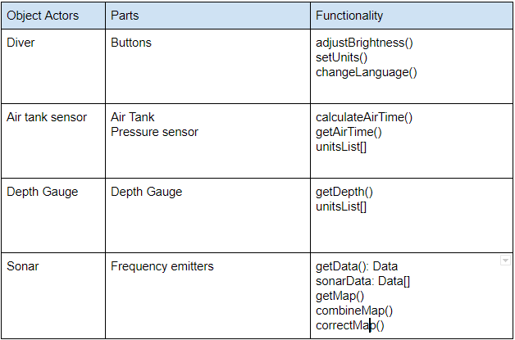
Access control

Slide 15
Boundary Conditions
Initialization
Defaults: English, Metric units, 50% brightness
Adjustable once turned on
Usable out of the box!
Normal Start-up
Retains persisted setting from last shut off
Shutdown
Saves current settings for next usage

Slide 16
Thanks for listening, here's a dolphin!

